Slide 1
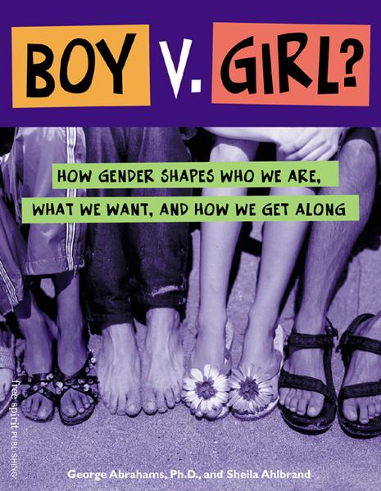
Gender Stereotypes
By: Danielle York

Slide 2
Gender vs. Sex
Gender refers specifically to socially constructed and institutionalized differences such as gender roles and gender identity (an individual’s self conception of being male or female). In common speech, it is mistakenly used interchangeably with “sex”
Biological Sex is expressed in genetics; refers to whether a person is male or female

Slide 3
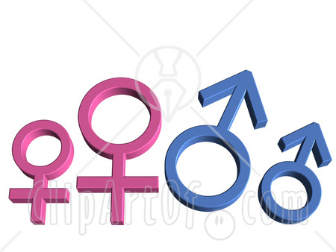
As educators, and as people, we tend to assume that females and males are different — are indeed “opposite sexes.” We see someone’s sex as an important predictor of their abilities and interests and assume that if we know someone is a girl or a boy, we know a lot about them.
This assumption is WRONG!!

Slide 4
Stereotype
It’s a stereotype if it ascribes characteristics to an individual based solely on group membership.
For example: a tall, thin young African American male is a basketball player or that an Asian student is good in math.
“Susie will be better than Ed at babysitting because she is a girl”

Slide 5
Gender Role Myths
Women aren’t good at math
Role models should be the same sex as the student (i.e. girls learn better from female teachers)
If something applies to Caucasian girls, it also applies to African American or Hispanic girls
Boys are rough, girls are fragile
Boys play in the dirt and with trucks, girls play with dolls and kitchen sets
Girls do dishes while boys mow the yard
Females are better at nurturing, males are better at making money

Slide 6


Common Gender Stereotypes
Women are:
submissive
emotional
quiet
neat
clean
clumsy
artsy
housewife
childrearing
Men are:
aggressive
no emotions
loud
messy
athletic
math and science oriented
money maker
naughty

Slide 7
Parental & Societal Influence
A child's sense of self, or self concept, is a result of the multitude of ideas, attitudes, behaviors, and beliefs that he or she is exposed to. The information that surrounds the child and which the child internalizes comes to the child within the family arena through parent-child interactions, role modeling, reinforcement for desired behaviors, and parental approval or disapproval. As children move into the larger world of friends and school, many of their ideas and beliefs are reinforced by those around them. A further reinforcement of acceptable and appropriate behavior is shown to children through the media, in particular, television. Through all these socialization agents, children learn gender stereotyped behavior. As children develop, these gender stereotypes become firmly entrenched beliefs and thus, are a part of the child's self concept.

Slide 8
Parental & Societal Influence
A child’s earliest exposure to what it means to be male or female comes from their parents.
From the time children are babies, parents treat boys and girls differently, dress them in gender specific clothes, buy them gender differentiated toys, and expect different behavior from their sons and daughters.
http://www.youtube.com/watch?v=XFdbZHMBxfg

Slide 9
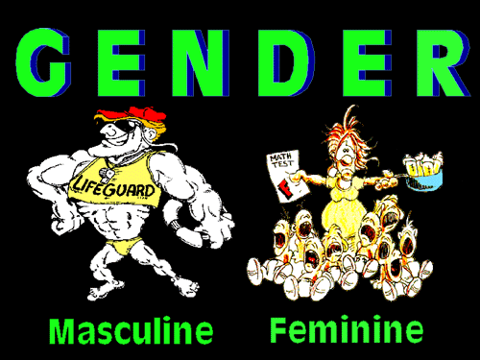
BEM Androgyny Test
Feminine
Nearly Feminine
Androgynous
Nearly Masculine
Masculine
Which are you?
Did anyone’s results surprise them?

Slide 10
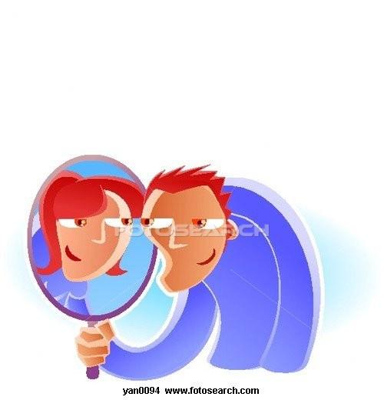
BEM Androgyny Test
◊ Even if a student is biologically female, she could express masculine traits or androgynous traits.
◊ Even if a student is biologically male, he could express feminine or androgynous traits.
How do you think you would treat a female student who expressed more masculine traits?
How do you think you would treat a male student who expressed more feminine traits?

Slide 11
Androgynous Traits in Parents
Families with one or more androgynous parent (i.e., a mom who repairs the family car or a dad who bakes cookies for the PTA meeting) have been found to be highest on scores of parental warmth and support.
These androgynous parents are found to be highly encouraging regarding achievement and developing a sense of self worth in sons and daughters.

Slide 12

Gender Equality in the Classroom
As for the teachers and teacher trainers, the problem at using gender stereotypes occurs when teachers find themselves making assumptions about members of their own or the opposite sex. Some of the researchers claim that “one of the more important reasons explaining the gaps between sexes is the teachers’ stereotyped attitudes towards the girls and boys in the classrooms. These can be described as sexist attitudes, although the teachers themselves are usually not aware of such reactions.”

Slide 13
Gender Equality in the Classroom
◦ Studies show that there are gender differences in communication in the classroom.
▪ Boys tend to speak more freely and spontaneously in class, formulating their answers as they speak.
▪ Girls tend to wait longer to respond to a question in class, choosing their words carefully, reflecting on the question and constructing an answer before they speak.
▪ Females tend to be interrupted more, thus they get the message that their contributions are not as valuable and may hesitate to join future discussions.

Slide 14
What Teachers Can Do…
Encourage class participation.
Be aware of whom you are calling upon and how you respond to their questions’ answers.
Be careful about the language and materials. Use gender neutral language.
Encourage the use of study groups.
Create a better sense of community.
Rearrange the classroom setting.
Make yourself available.
Choose examples from opposite stereotypical groups.

Slide 15
Resources
Aksu, B. (2005). Barbie Against Superman: Gender Stereotypes and Gender Equity in the Classroom. Journal of Language and Linguistic Studies, 1(1), 12-21.
Campbell, P. B. & Storo, J. N. (1994). Girls are, Boys are: Myths, Stereotypes, and Gender Differences. Massachusetts: Campbell-Kibler Associates.
Witt, S. D. (1997). Parental Influence on Children’s Socialization to Gender Roles. Ohio: School of Home Economics and Family Ecology.

